Slide 1
Unit 2
Medium Access Control

Slide 2
Contents
Motivation for special MAC: Hidden & Exposed Terminal, Near & Far Terminal.
SDMA, FDMA, TDMA, CDMA, Aloha,
Reservation Schemes
Collision avoidance
MACA
Polling
multiplexing schemes comparison.

Slide 3
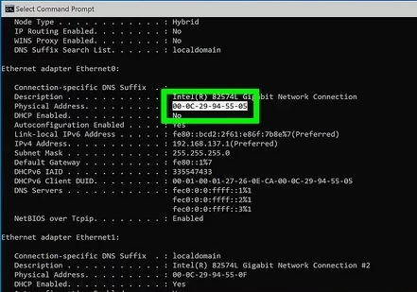
introduction
When a device is connected to a network, it obtains a unique MAC address. It identifies a device connected to a network. The MAC address, also known as the hardware address
It ensures that various devices can transmit data effectively and fairly over a common communication path like a wired Ethernet or wireless Wi-Fi network.

Slide 4
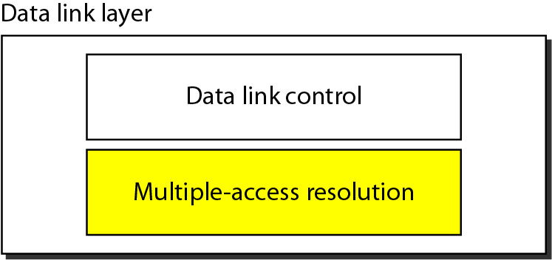
Data link layer divided into two functionality-oriented sublayers
Responsible for error and flow control
Link Layer Control (LLC)
Control
MAC
Responsible framing and MAC address and Multiple Access Control

Slide 5
Multiple Access
Problem: When two or more nodes transmit at the same time, their frames will collide and the link bandwidth is wasted during collision
How to coordinate the access of multiple sending/receiving nodes to the shared link???
Solution: We need a protocol to coordinate the transmission of the active nodes
These protocols are called Medium or Multiple Access Control (MAC) Protocols belong to a sublayer of the data link layer called MAC (Medium Access Control)
What is expected from Multiple Access Protocols:
Main task is to minimize collisions in order to utilize the bandwidth by:
Determining when a station can use the link (medium)
what a station should do when the link is busy
what the station should do when it is involved in collision

Slide 6
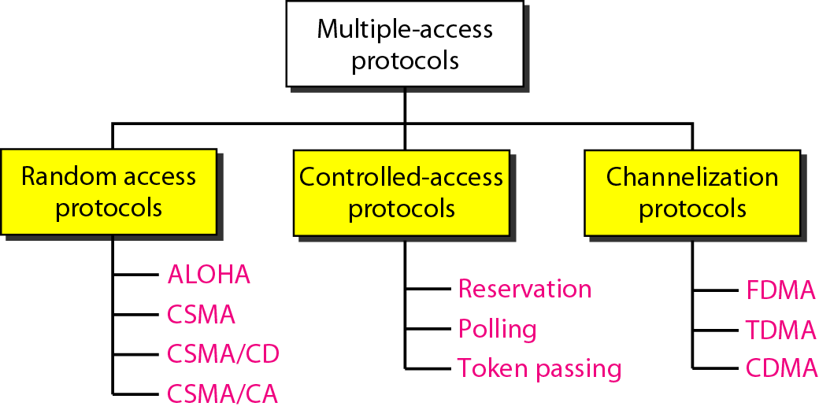
For wireless

Slide 7
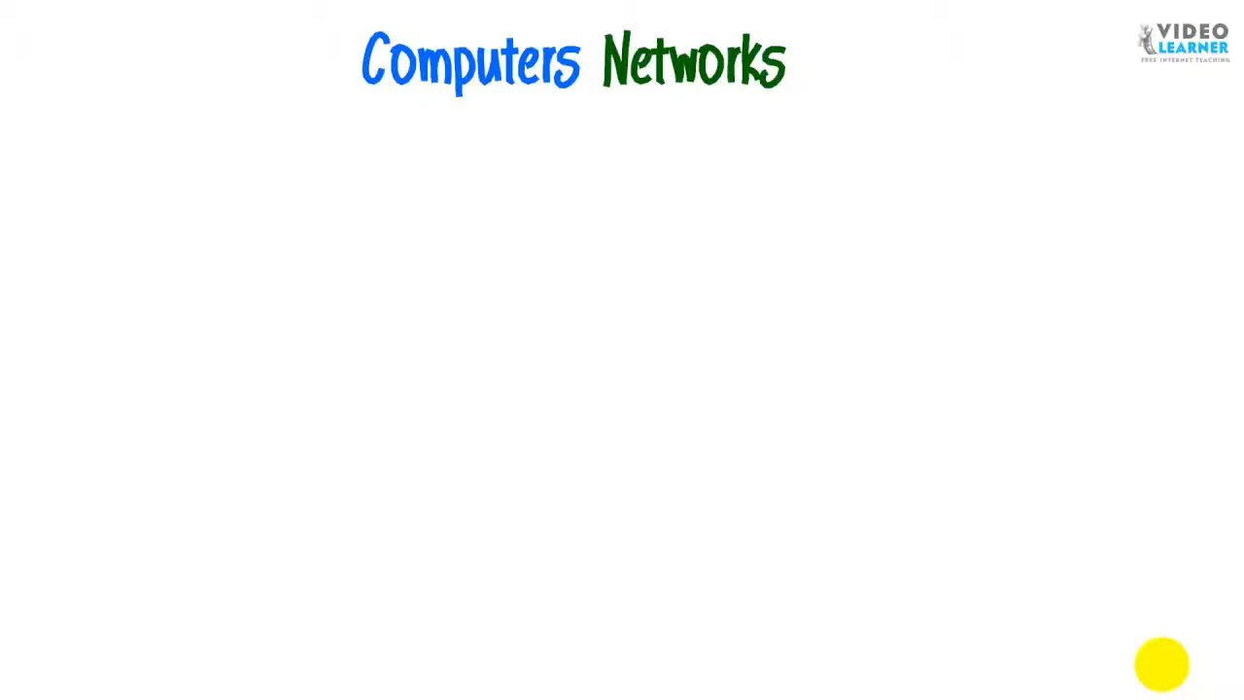

Slide 8
Medium Access in Wireline
Assumptions
Signal strength is constant throughout the wire
Signal condition detected at one end is same at the other
Same signal strength can be assumed all over the wire, if the length of wire remains within standard limit.
Collisions can be detected by any node listening to the wire
CSMA/CD operation (wireline protocol)
carrier sense – listen on wire and confirm that medium is free; if yes, send packet
collision detection – listen while transmitting; if collision detected (certain signal pattern); stop sending, block medium – send jam signal

Slide 9
Medium Access in Wireless
Signal strength is not constant throughout the medium
Signal attenuates with distance; condition detected at one end is not same at the other
Strength of a signal decreases proportionally to the square of the distance to the sender.
Collisions at receiver cannot be detected by listening to the medium
CSMA/CD operation in wireless
carrier sense – medium free maybe detected at sender; condition may not hold at receivers end
collision detection – similar problem; collision may have occurred at receiver; sender may not be aware

Slide 10
Wireless Medium Access Problems Terminology – Hidden / exposed terminals
B in range of A and C
A and C cannot hear each other
A transmits, C can sense medium free and vice versa (Hidden terminals)
Collision at B if both transmit at same time
If B transmits to A
C senses medium busy
C could have transmitted
to D; without any collisions
C is exposed terminal (~ A)
A
B
C
D

Slide 11
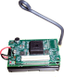
Hidden Terminal Problem
Other senders’ information are hidden from the current sender, so that transmissions at the same receiver cause collisions.
R
S1
S2

Slide 12
Exposed Terminal Problem
The sender mistakenly think the medium is in use, so that it unnecessarily defers the transmission.
S1
S2
R1
R2
R₁
CTS
1
S₁
2
3
RTS
DATA
S₂
Find medium in use
Wait until medium is clear
R₂
time

Slide 13
Wireless Medium Access Problems Terminology – Near / far terminals
B closer to C, compared to A
B’s signal drowns that of A
Signal from source B is overpowering or dominating the signal from source A
C may not hear A; A not visible
C cannot receive A’s transmission
Critical issue in CDM v/s GSM which has time slots for all terminals
GSM: No simultaneous transmission
CDM has simultaneous transmission
CDM: All terminals should be detectable
by base station
A
B
C

Slide 14
Multiplexing
Describes how several users can share a medium with minimum or no interference.
Many users (car drivers) use the same medium (the highways) with hopefully no interference (i.e. accidents)
Possible due to the provision of several lanes separating the traffic.
Also different cars use the same medium (i.e, the same lane) at different points in time.

Slide 15
Multiplexing
The wireless channels can be multiplexed in four dimensions:
Time(t): A channel gets the whole frequency spectrum for a certain amount of time.
Space(s): Same frequency can be reused when the base stations are separated in space.
Frequency(f): The whole spectrum is separated into smaller frequency bands.
Code(c):Each channel uses a unique code for transmitting.

Slide 16
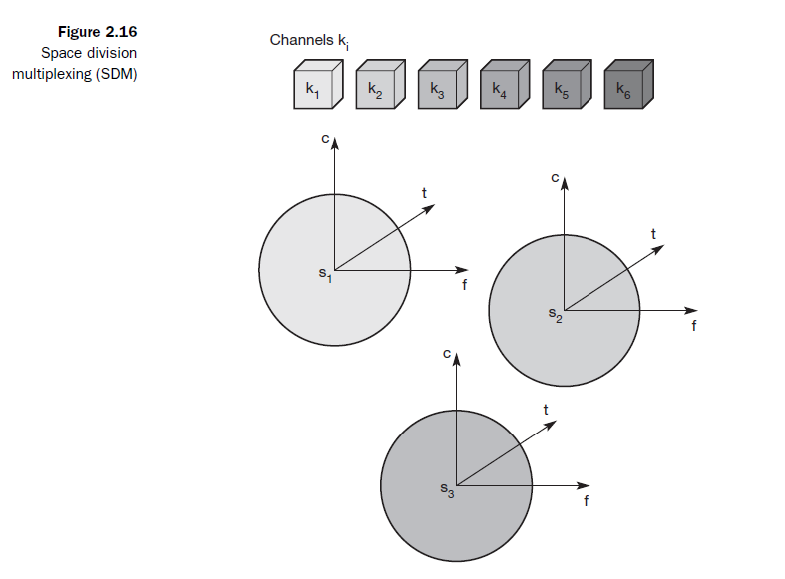
Spatial Division Multiplexing (SDMA)
For remaining K₄ to K₆ other three additional space is required.
Highway example – Each driver had his or her own lane
Old Telephone systems- each subscriber is given a separate pair of copper wires to local exchange.
SDM example –FM radio station in Mumbai and Ahmedabad can use same frequency –as they are not in same range.

Slide 17
Space Division Multiplexing (SDMA)
Cellular transmission –each cell uses frequency other than its neighboring cell.
If several radio stations want to broadcast in the same city - Solution?

Slide 18
Space Division Multiplexing (SDMA)
If several radio stations want to broadcast in the same city - Solution?
SDM not suitable
Solution:
Multiplexing through
Frequency
Time
Code

Slide 19
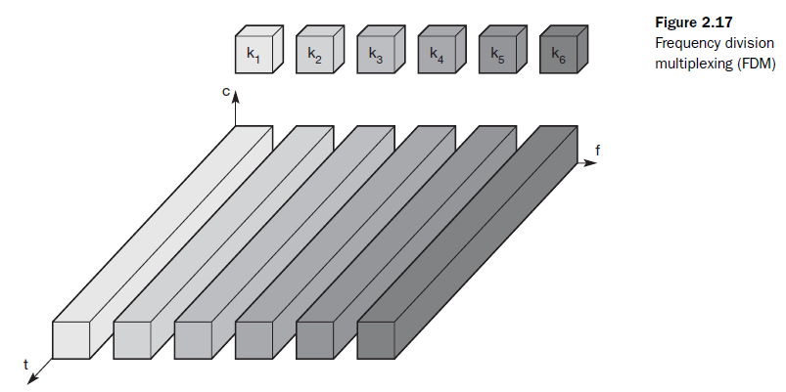
Frequency Division Multiplexing (FDMA)
Each channel K_{i} has its own frequency band
Senders using a certain frequency band can use this band continuously.
Guard space required

Slide 20
Frequency Division Multiplexing (FDMA)
Example: Radio stations within same region – will have their own frequency for transmitting. Used for radio stations within same range.
Advantage: Very Simple scheme – To receive data, receiver only has to tune to particular sender's frequency.

Slide 21
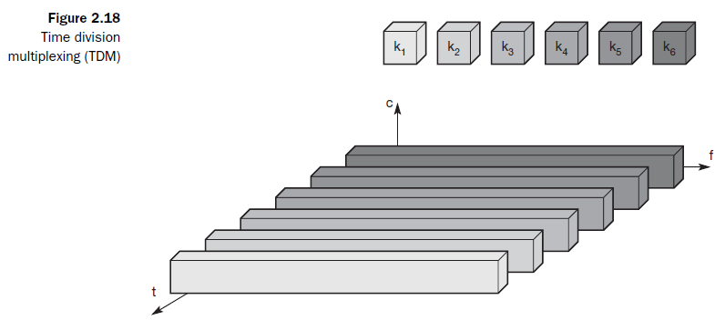
Time Division Multiplexing (TDMA)
Each channel is given the whole bandwidth for certain amount of time.
All senders use the same frequency but at different point of time.
Guard space required - in terms of time. Between previous transmission and next transmission there should be some time gap.

Slide 22
Time Division Multiplexing (TDMA)
Synchronization required between transmitter and receiver.
Advantage and Disadvantage?

Slide 23
Time Division Multiplexing (TDMA)
Disadvantage:
All senders need time synchronization
For a receiver tuning in to a sender – need to adjust to sender’s frequency as well as correct time slot.

Slide 24
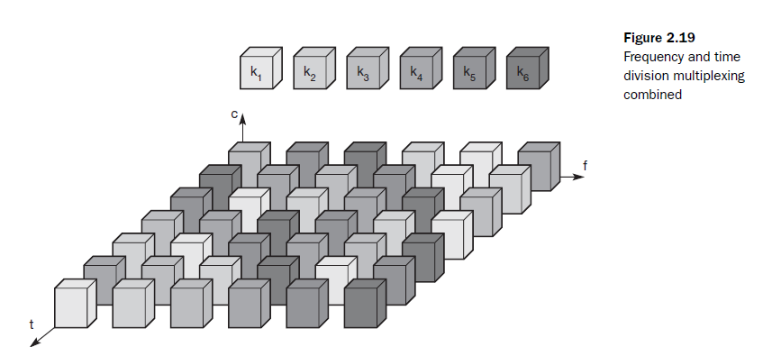
Time +Frequency Division Multiplexing (TDMA+FDMA)
Each channel can use certain frequency for certain amount of time.
Guard space needed in both terms –time and frequency
Standard GSM uses – time + frequency multiplexing

Slide 25
Time +Frequency Division Multiplexing (TDMA+FDMA)
Disadvantage?

Slide 26
Time +Frequency Division Multiplexing (TDMA+FDMA)
Disadvantage
Necessary coordination between different senders.
One has to control the sequence of frequencies and the time of changing to another frequency.
Two senders will interfere as soon as they select same frequency at the same time.

Slide 27
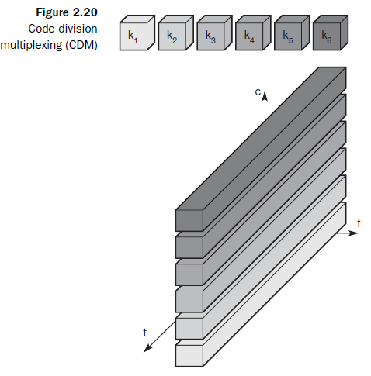
Code Division Multiplexing (CDMA)
Every channel uses same frequency at same time
Separation is achieved by assigning each channel its own code.
Guard space is achieved – by taking care that each channel is assigned different code.

Slide 28
Code Division Multiplexing (CDMA)
Example: Party with many participants from different countries around the world - talk to each other at same time.
If everybody speaks at same time –SDM required – standing in groups and communicating

Slide 29
Code Division Multiplexing (CDMA)
But as soon as another language is used one can tune to that language - and separate communication in this language from all the other languages.
CDM security – signal is received – receiver will decode it using sender’s code

Slide 30
Code Division Multiplexing (CDMA)
Disadvantage:
Complex receiver - has to know the code for decoding
All signals must reach receiver with same strength –otherwise some signals could drain others.
If some people close to a receiver talk very loudly the language does not matter. The receiver cannot listen to any other person.
CDM – power control is required.

Slide 31
TDMA
Dynamic allocation
Sender may transmit in any slot
Could any problems occur? What the sender needs to do? What receiver needs to do?
Fixed allocation
Sender will transmit in fixed slots
Could any problems occur? What the sender needs to do? What receiver needs to do?

Slide 32
TDMA
Dynamic allocation
Sender may transmit in any slot
Receiver has to know whether it is intended receiver; sender identification is required for response
Alternate: Announce the allocation scheme periodically
Good for dynamic loads
Fixed allocation
Sender will transmit in fixed slots
Sender and receiver tune in for specific slots; identification not necessary
Good for static loads

Slide 33
Fixed TDM
Allocate time slots for channels in a fixed pattern.
So Fixed bandwidth
If synchronization is assured- each mobile station knows its turn and no interference
Fixed pattern can be assigned by the base station – where competition between different mobile station is solved.

Slide 34
Fixed TDM
Fixed access pattern:
Suitable for connections with a fixed bandwidth
Guarantee a fixed delay- e.g one can transmit after every 10 ms.
Used in many digital mobile phone systems lie IS54, IS13, GSM, DECT

Slide 35
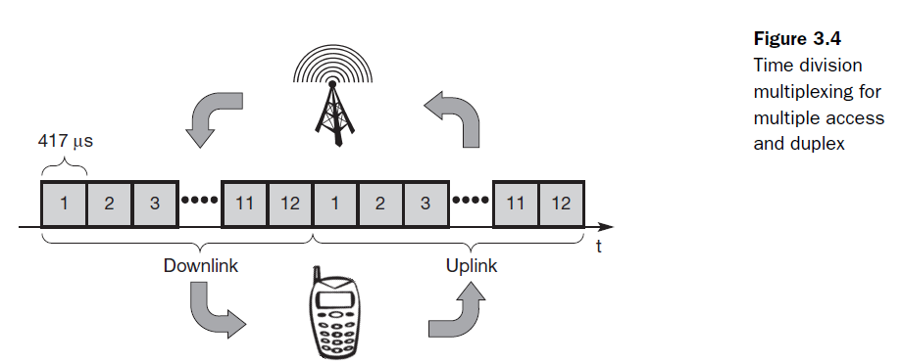
Fixed TDM
Time Division Duplex: Assigning different uplink and downlink slots between base station and mobile station.

Slide 36
Fixed TDM
Fixed access pattern:
Perfect for connections with constant data rate.
Inefficient for bursty or asymmetric or dynamic traffic patterns.
If temporary bursts in data are sent from the base station to the mobile station often or vice versa (as in the case of web browsing, where no data transmission occurs while reading a page, whereas clicking on a hyperlink triggers a data transfer from the mobile station, often to the base station, often followed by huge amounts of data returned from the web server)
Too static – inflexible for data communication
Needs – connectionless, demand oriented TDMA schemes

Slide 37
Dynamic TDM Demand Oriented TDMA - Simple Aloha
Simple MAC
Node just sends the data, whenever it wants to
If collision, resend – resolving problems left to higher layers
Pro: Simple MAC
Con: Collisions
Aloha scheme (cannot be called a MAC☺) – but good for light load
Achieves maximum throughput of ~18%
Can Aloha handle Hidden/exposed terminal problem?

Slide 38
TDM Slotted Aloha
Simple MAC
Node just sends the data, whenever it wants to, but starts at a slot boundary
Slots reduce the probability of collision
If collision, resend
Achieves maximum throughput of ~36%
Can Slotted Aloha handle Hidden/exposed terminal problem?

Slide 39
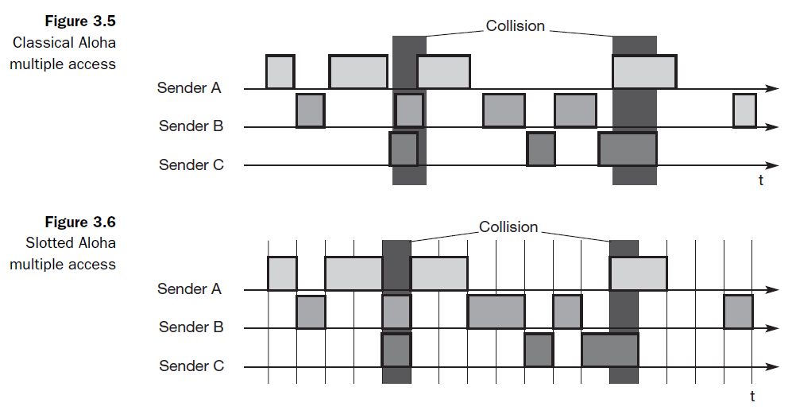
Simple Aloha\ Slotted Aloha

Slide 40
MAC Design Principles
Limited resources to be allocated to a set of users
Choose suitable dimension(s) to partition the resource
Space, time, frequency, code, etc.
Decide technique for optimal allocation of resources to the users, in the selected dimension
E.g. time → TDMA

Slide 41
MAC Design Approaches
Centralized scheme
Distributed scheme
Single base station or master
All other nodes are slaves
Master controls access to medium
Examples: Wireless LAN, cellular network with base station
Pros:
Simple implementation
Master is a bottleneck
Cons:
Single point of failure
Master needs to be re-elected on failure
E.g. Polling / Probing
All nodes contend for medium
No central controlling station
Pros:
Lesser delays (why?)
Cons:
Complex implementation

Slide 42
Performance metrics
Normalized throughput
fraction of link capacity used to carry non-retransmitted packets
example
with no collisions, 1000 packets/sec
with a particular scheme and workload, 250 packets/sec
=> Throughput = 0.25
Mean delay
amount of time a station has to wait before it successfully transmits a packet
depends on the load and the characteristics of the medium

Slide 43
Performance metrics
Stability
with heavy load, is all the time spent on resolving contentions?
=> unstable
with a stable algorithm, throughput does not decrease with offered load
if infinite number of uncontrolled stations share a link, then instability is guaranteed
but if sources reduce load when overload is detected, can achieve stability
Fairness
no single definition
‘no-starvation’: source eventually gets a chance to send
max-min fair share
Source: http://www.cs.cornell.edu/skeshav/book/slides/index.html
S. Keshav, An Engineering Approach to Computer Networking

Slide 44
Medium Access Control Review
Control user access to the medium
Traffic signal analogy
One vehicle passes at a time at a crossing
If there is a collision, wait till road cleared, start again
Medium access control can be centralized or decentralized
Improvised MAC required for wireless (?later)

Slide 45
Medium Access in Wireless Review
Wireline assumptions fail
Signal strength is not constant throughout the medium
Signal attenuates with distance; condition detected at one end is not same at the other
Collisions at receiver cannot be detected by listening to the medium
CSMA/CD operation in wireless
Hidden / exposed terminal problems
Near / far terminal problems
TDMA
Dynamic or Fixed slot allocation
Aloha – simple MAC

Slide 46
Improving Aloha
Aloha
Low Throughput
What is missing in Aloha?
How can it be improved?

Slide 47
Improving Aloha Carrier Sense Multiple Access (CSMA)
What is missing in Aloha?
Carrier sensing not done; a node transmits whenever it node wants to
How to improve?
Sense the carrier before transmission
Will this improve Aloha?

Slide 48
Persistence Methods
1 Persistent CSMA
In 1-persistent CSMA, the station continuously senses the channel to check its state i.e. idle or busy so that it can transfer data or not.
In case when the channel is busy, the station will wait for the channel to become idle.
When station found idle channel, it transmits the frame to the channel without any delay.

Slide 49
1 Persistent CSMA
It transmits the frame with probability 1.
Due to probability 1, it is called 1-persistent CSMA.
Disadvantages:
The problem with this method is that there are a large number of chances for the collision it is because there is a chance when two or more stations found channel in idle state and the transmit frames at the same time.
On the time when collision occurs the station has to wait for the random time for the channel to be idle and to start all again.

Slide 50
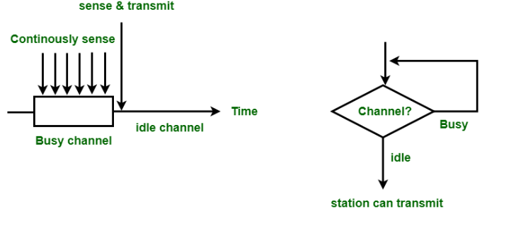
1- Persistent CSMA

Slide 51
Non-Persistent CSMA
In this method, the station that has frames to send, only that station senses for the channel.
In case of an idle channel, it will send frame immediately to that channel.
In case when the channel is found busy, it will wait for the random time and again sense for the state of the station whether idle or busy.
In this method, the station does not immediately sense for the channel for only the purpose of capturing it when it detects the end of the previous transmission.

Slide 52
Non-Persistent CSMA
The main advantage of using this method is that it reduces the chances of collision.
The problem with this is that it reduces the efficiency of the network.

Slide 53
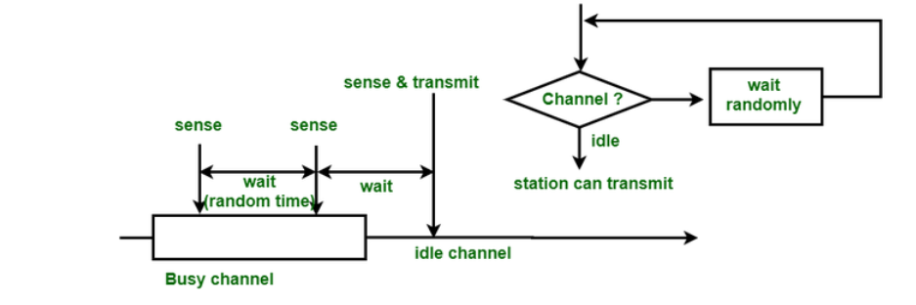
Non-persistent CSMA

Slide 54
Q&A
What is the difference between 1 persistent and non persistent CSMA ?

Slide 55
P-Persistent CSMA
P-Persistent CSMA is applied to Slotted Channels.
When a station becomes ready to send, it senses the channel.
If it is idle, it transmits with a probability P
With a probability Q=1-P, it defers until the next slot
If that slot is also idle, it either transmits or defers again , with probabilities P and Q.
This process is repeated until either the frame has been transmitted or another station has begun transmitting.
If the station initially senses the channel busy, it waits until the next slot and applies the above algorithm.

Slide 56
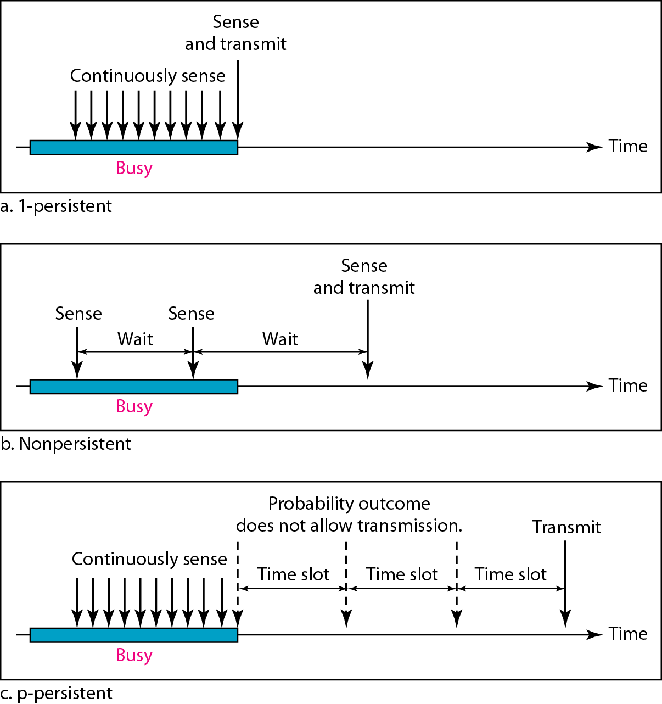
Figure 12.10 Behavior of three persistence methods

Slide 57
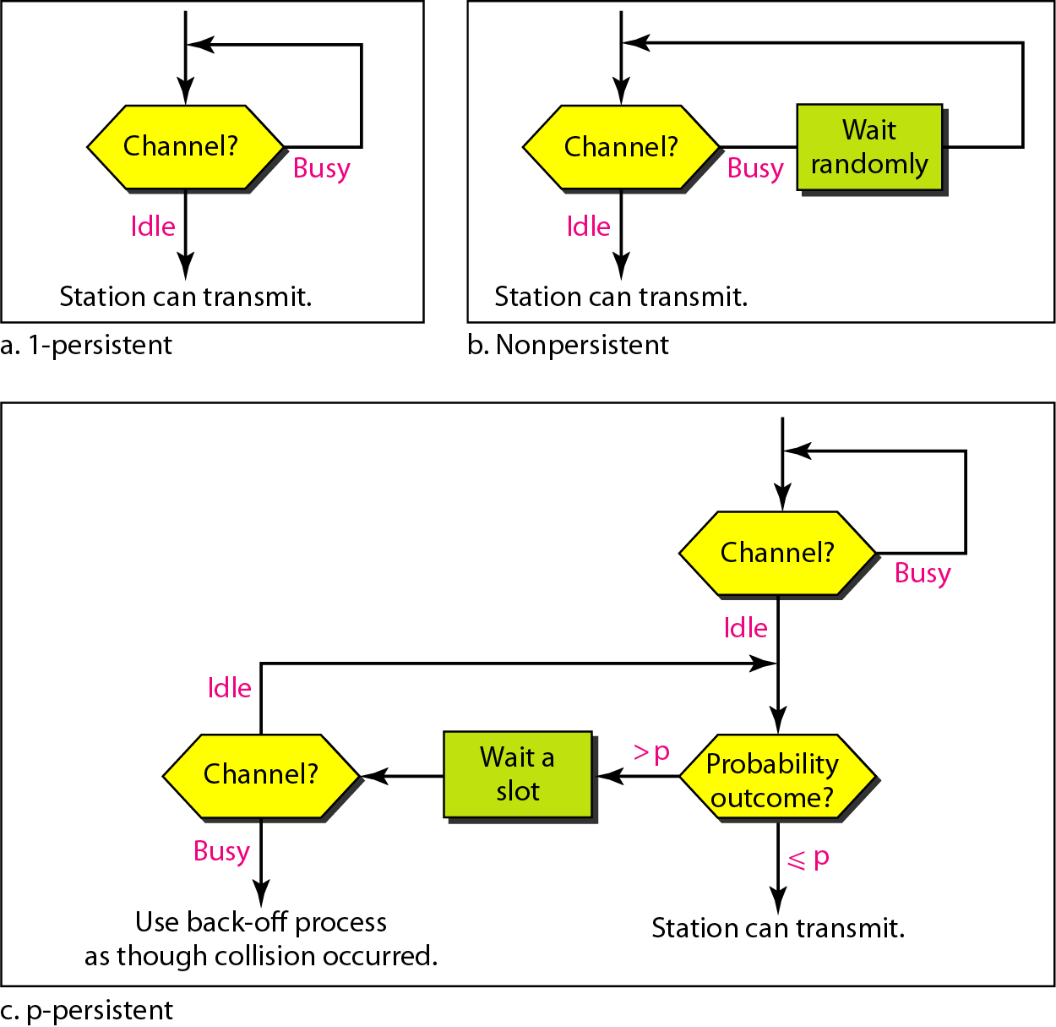
Figure 12.11 Flow diagram for three persistence methods

Slide 58
Improving Aloha Carrier Sense Multiple Access (CSMA)
When medium sensed two possibilities
Medium busy or free
If medium free → transmit immediately
If medium busy → wait (how long?)
Goto (a)
This is non-persistent CSMA; what are the variables?
Improving CSMA: the variables here are
wait time – when to sense again
instant when to transmit

Slide 59
Improving Aloha Carrier Sense Multiple Access (CSMA)
Wait time and transmit instant – each can be
Random, 0, changing according to some algorithm
Wait time
0 = persistent
Random = non-persistent
Transmit instant
Transmit with probability ‘p’
Node can transmit now, since medium is free
It tosses a coin and then decides (p=0.5)
If wait time=0; and p=1 then called p-persistent CSMA

Slide 60
Improving Aloha
How can Aloha be improved, if a central controller is available?
Justify your design
Discuss the pros/cons

Slide 61
Improving Aloha Demand Assigned Multiple Access
Improvement of Aloha access systems can also be achieved by reservation mechanisms and combinations with some (fixed) TDM patterns.
These schemes typically have a reservation period followed by a transmission period.
Explicit reservation of slots
Initially regular Aloha; only for reservation of slots
Later data transmission in assigned slots
No collisions during data transmissions

Slide 62
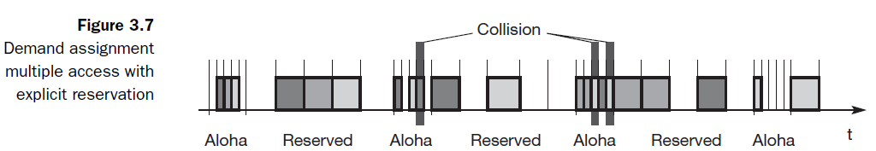
Improving Aloha Analyzing DAMA

Slide 63
Improving Aloha Analyzing DAMA
Initial time needed to reserve slots
If there are few or one nodes, time is wasted in reserving slots
If too many contending nodes, slot assignment may take more time
Slots are assigned after Aloha
No mechanism to assign priorities to nodes
A node may always lose the Aloha competition!
Is this possible? How to ensure fairness?

Slide 64
Improving Aloha Analyzing DAMA
Different stations on earth try to reserve access time for satellite transmission.
Collisions during the reservation phase do not destroy data transmission, but only the short requests for data transmission.
If successful, a time slot in the future is reserved, and no other station is allowed to transmit during this slot.
Therefore, the satellite collects all successful requests (the others are destroyed) and sends back a reservation list indicating access rights for future slots.
All ground stations have to obey this list.
To maintain the fixed TDM pattern of reservation and transmission, the stations have to be synchronized from time to time.
DAMA is an explicit reservation scheme. Each transmission slot has to be reserved explicitly.

Slide 65
Implicit Reservation
Aloha
Use data for getting a slot and transmitting
Contend for all packet transmissions
DAMA
Explicit reservation of slots, before sending data
Do not use data for reservation
Another approach
Use data for implicit reservation
Hold on to reservation till done – Packet Reservation Multiple Access

Slide 66
Packet Reservation Multiple Access
Reservations for cellular domain
Centralized medium access
Devices have speech and data packets to send
Speech is periodic; when started will continue for some time
slots required for some period
Speech and data packets contend for resources (slot)

Slide 67
Packet Reservation Multiple Access
A certain number of slots combine to form a frame.
Frame is repeated in time.
A base stations – ex: satellite – broadcasts the status of each slot.
All stations receiving vector – will know which slot is occupied and which slot is free.
As soon as station has succeeded with a reservation, all future slots are implicitly reserved for this slot.
The slotted aloha scheme is used for idle slots- data is not destroyed.

Slide 68
Distributed Packet Reservation Multiple Access Protocol (D-PRMA)
Implicit reservation (PRMA - Packet Reservation Multiple Access):
a certain number of slots form a frame, frames are repeated
stations compete for empty slots according to the slotted aloha principle
once a station reserves a slot successfully, this slot is automatically assigned to this station in all following frames as long as the station has data to send
competition for this slots starts again as soon as the slot was empty in the last frame 1.
reservation
1
2
3
4
5
6
7
8
time-slot
ACDABA-F
frame₁
A
C
D
A
B
A
F
ACDABA-F
frame₂
A
C
A
B
A
AC-ABAF-
frame₃
A
B
A
F
collision at reservation attempts
A---BAFD
frame₄
A
B
A
F
D
ACEEBAFD
frame₅
A
C
E
E
B
A
F
D
t
Notes:
25

Slide 69
Access method DAMA: Reservation-TDMA
Reservation Time Division Multiple Access
every frame consists of N mini-slots and x data-slots
every station has its own mini-slot and can reserve up to k data-slots using this mini-slot (i.e. x = N * k).
other stations can send data in unused data-slots according to a round-robin sending scheme (best-effort traffic)
e.g. N=6, k=2
N mini-slots
N * k data-slots
reservations for data-slots
other stations can use free data-slots
based on a round-robin scheme
Notes:
26

Slide 70
Protocols till now..
FDMA, TDMA
TDM – Fixed, dynamic
Aloha, Slotted Aloha
Carrier sense multiple access – Collision avoidance (CSMA\CA)
Demand assigned multiple access (DAMA)
Packet reservation multiple access (PRMA)
Reservation TDMA
Protocols without central controller, do not solve hidden terminal\exposed terminal problems
Protocols with central controller, Central base station assigning TDM patterns.
Hidden terminal problem – unknown
If the terminal is hidden it cannot communicate anyway.

Slide 71
Requirement
No central controller
Need of dynamic reservation – not fixed reservation (as in fixed TDM, PRMA)
Solve hidden terminal and exposed terminal problem.

Slide 72
Multiple access with collision avoidance (MACA)
Solves hidden\exposed terminal problem.
Does not need a base station (central controller)
Still a random access aloha scheme – with dynamic reservation.

Slide 73
Multiple access with collision avoidance (MACA)
MACA
When a node wants to transmit a data packet, it first transmit a RTS (Request To Send) frame.
The receiver node, on receiving the RTS packet, if it is ready to receive the data packet, transmits a CTS (Clear to Send) packet.
Once the sender receives the CTS packet without any error, it starts transmitting the data packet.
If a packet transmitted by a node is lost, the node uses the binary exponential back-off (BEB) algorithm to back off a random interval of time before retrying.

Slide 74
Multiple access with collision avoidance (MACA)
What RTS and CTS frame will include?
Sender’s name
Receiver's name
Length of the future transmission

Slide 75
MACA examples
MACA avoids the problem of hidden terminals
A and C want to send to B
A sends RTS first.
B will receive RTS .
C cannot here RTS send by A.
B will send CTS to A.
C can listen to CTS send by B.
C waits after receiving CTS from B
RTS
CTS
CTS
A
B
C
B

Slide 76
MACA examples
MACA avoids the problem of exposed terminals
B wants to send to A, C want to send to D.
B will send RTS to A.
RTS will be received by C also.
A will send CTS to B. C can’t listen CTS from A.
So C will continue its transmission to D.
RTS
RTS
CTS
A
B
C
D

Slide 77
Multiple access with collision avoidance (MACA)
Is there any possibility of collision? Where and when?

Slide 78
Multiple access with collision avoidance (MACA)
Is there any possibility of collision? Where and when?
Collision can occur during sending of RTS.
Both A and C could send RTS to B at same time.
RTS is very small compared to the data transmission, so the probability of a collision is much lower.
B resolves contention and can acknowledge on station in the CTS (if it was able to recover the RTS at all).
No transmission allowed without an appropriate CTS.

Slide 79
Multiple access with collision avoidance (MACA)
Problem with MACA ?

Slide 80
Multiple access with collision avoidance (MACA)
Problem with MACA:
Overheads associated with the RTS and CTS transmissions.
For short and time critical data packets – not feasible.

Slide 81
MACA
sender
receiver
idle
idle
packet ready to send; RTS
data;
ACK
RxBusy
time-out;
RTS
wait for the
right to send
RTS;
CTS
time-out ∨
data;
NAK
ACK
time-out ∨
NAK;
RTS
CTS; data
wait for ACK
wait for
data
ACK: positive acknowledgement
NAK: negative acknowledgement
RxBusy: receiver busy
RTS; RxBusy

Slide 82
Polling
Can be applied when one station is to be heard by all others (the base station)
Strictly centralized scheme – with one master and several slave stations.
Master will poll slaves – according to round robin or randomly
Used in Bluetooth wireless LAN

Slide 83
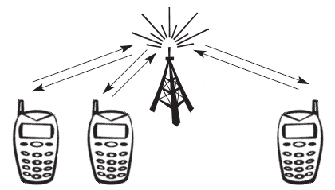
Inhibit Sense Multiple Access
Base station only signals a busy medium via a busy tone (called BUSY/IDLE indicator) on the downlink.
After the busy tone stops, accessing the uplink is not coordinated any further.
The base station acknowledges successful transmissions, a mobile station detects a collision only via the missing positive acknowledgement.

Slide 84
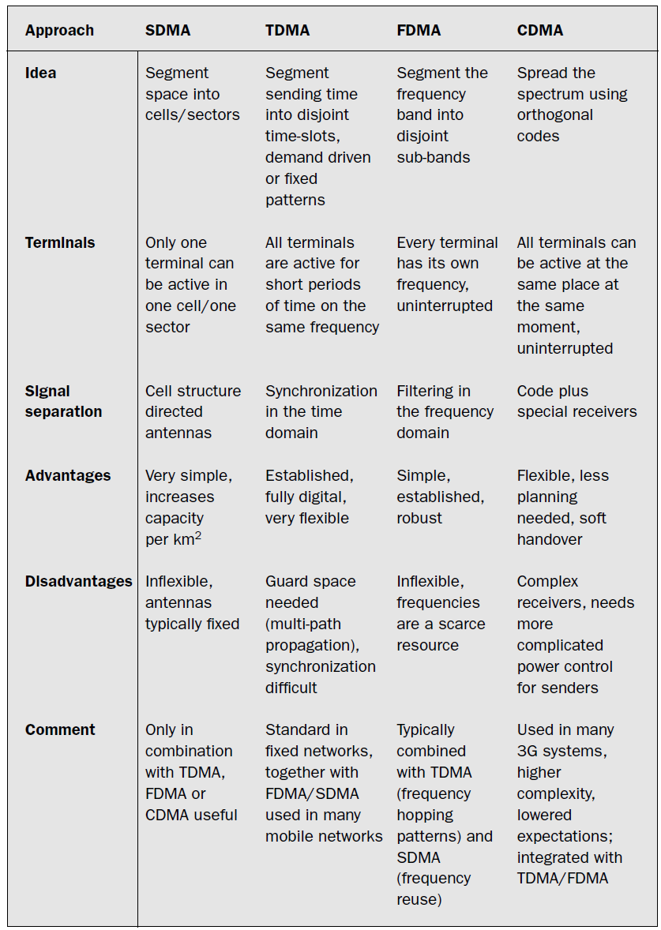
Comparison of S/T/F/CDMA

